Slide 1


SurveillanceSim Project
“Improving disaster preparedness and response through improved training and decision making”
Dr Chris Skelly
Institute for the Environment
Brunel University
chris.skelly@brunel.ac.uk

Slide 2

Introduction
We are a research & development team of two: a scientist and software developer working out of Brunel University’s Institute for the Environment
Funding: 3 strategies available
Objective: to dominate one or more market segments by August 2008
Purpose: year 1 operating, marketing and ‘whole product’ development

Slide 3
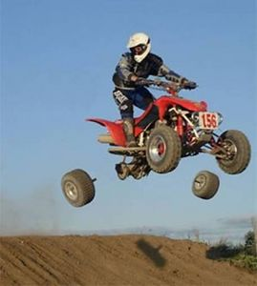
The Opportunity
Just imagine if…
a pilot shut down an engine in-flight to see if they would restart!
an engineer build a bridge with fewer welds to see if it would stand!
an environmental regulator allowed a discharge to see its effect!
These professionals simulate
Before the wheels come off!

Slide 4
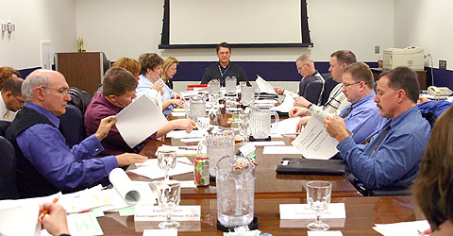
The Opportunity
How do public health and other decision-makers prepare for the unthinkable?
Hold meetings
Gather experts around a table
Hire renowned modellers
Have a consultant prepare a report

Slide 5

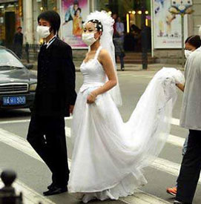
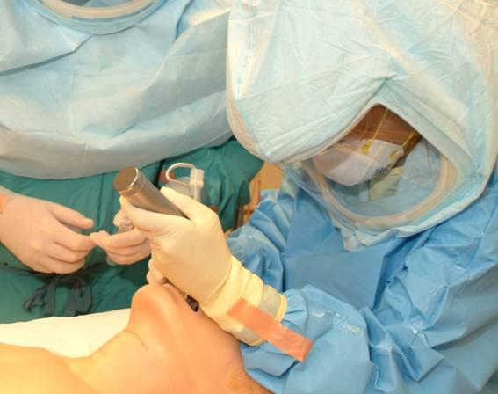

The Opportunity
Customers motivation to change behaviour?
    to add a new business process?
    to spend money on a decision support system?

Slide 6

Project Progress
ieSim Milestones and Targets 2007
    Feb – First product ‘delivered’
    May – User acceptance (testing)
    Jun – First product to market
    Aug – Bug fixes & users satisfied

Slide 7


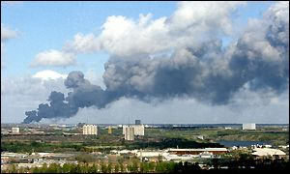
Benefits and USPs
ieSim aid preparedness planning
Allow decision makers to:
  visualize the dynamics of disaster
  simulate readiness and response
  evaluate response times
  quantify the costs
  contrast good and poor intervention decision-making
Learn the easy way – before disaster strikes!

Slide 8
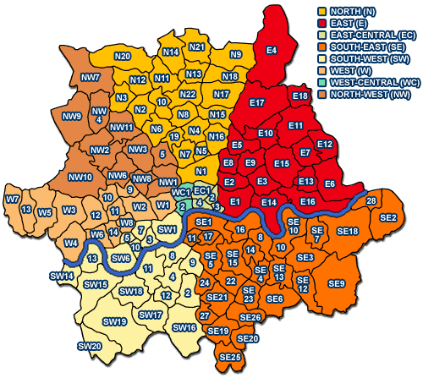
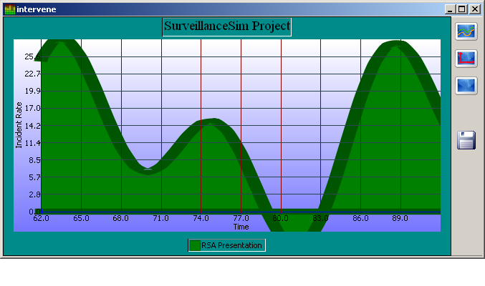
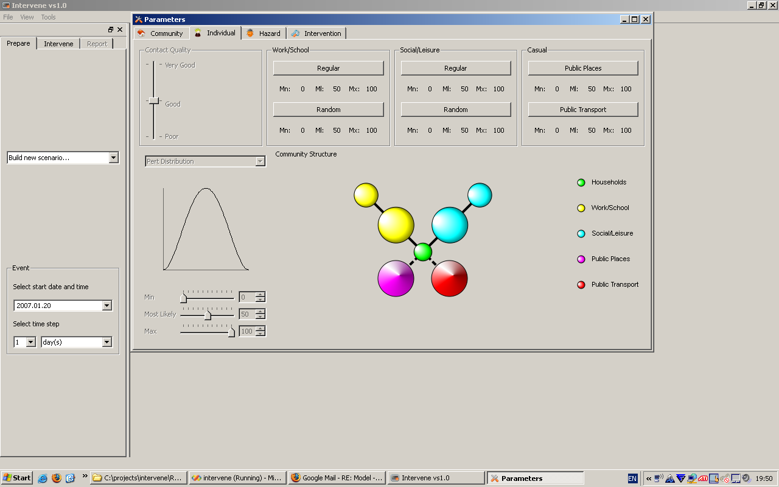
Benefits and USPs
ieSim tools are ‘simple’
Upload community data
Parameterize
  individuals & households
  communities
  hazards
  interventions
Run simulations
4. Learn – Evaluate - Improve

Slide 9

Benefits and USPs
ieSim is ‘plug and play’
Simulation is only a ‘click’ away
Consistent and intuitive ‘look and feel’
Simulations are visual
Business Model:
Buy in models from research groups
License 3rd party tools for ieSim environment
Provide vertical integration in training, practice and consulting

Slide 10

Benefits and USPs
ieSim leverages existing investments
corporate data
resident knowledge experts
training exercises

Slide 11

Benefits and USPs
ieSim delivers effectiveness
    Time: prepare and respond to disaster
    Money: better prepared, compliant with government regulations and policy
    Lives & property

Slide 12
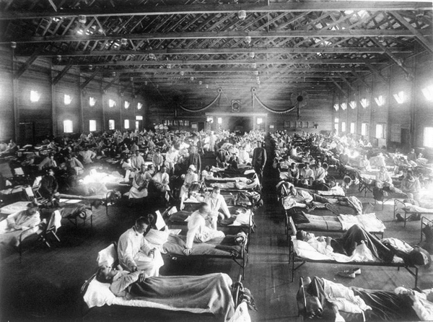

Slide 13

Intellectual Property
Skelly originated the idea for this product & Skelly-Simoes collaboration is delivering the current system
Software IP is currently protected by Copyright, but not registered
Trademarks are being developed, but have not been registered

Slide 14
Customer Engagement
Government Agencies
  Public Health Agency of Canada
  New Zealand Ministry of Health
  Centre for Health Protection, HK
  Singapore Ministry of Health
  UK HPA & NHS
  US CDC
  New York State Health Department
  Malaysian Ministry of Health
  Thai Ministry of Public Health
  Department of Health, West Australia
NGOs
  World Health Organisation
  Medicine Sans Frontiers
Education
  University of Western Australia
  Guelph University
  Brunel University
Industry Partnerships
  Infonaut, Toronto
  ESI911, Atlanta
  ESR, Wellington

Slide 15
“Feedback”
Government Agencies
  “we like”
  “see potential”
  “can we have a look and play”
Education
  “have need now!”
  “priced for students?”
  “priced for academics?”
Industry Partnerships
  “we can sell this”
  “we have customers now”
  “can we value-add?”
  “is it GIS compatible?”
NGOs
  “wonderful”
  “who will fund it?”

Slide 16

Market
Customer base
  public health
  local and regional government
  various planning authorities
  Training centres & groups
  Industry – facilities management
Supply chain
  Direct via the Internet
  Technology resellers
  Independent 3rd parties supporting ‘whole product’

Slide 17
Market
Global Market
Government
  National > 1,000
  Regional > 100,000
  Edu > 1,000
Non-Gov > 1,000
Facilities > 1,000,000
Who needs to prepare for community wide disaster; who needs business continuity?
We need to sell
  150 packages
  @ £1,000
  To cover salaries and operating in year-one with a turnover of £150,000

Slide 18
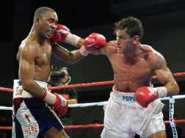
Competition
Very few modelling groups
    provide consultancy
    “very sophisticated”
    very expensive, not timely
Avoid head-to-head competition
  Provide “first pass estimation”
  Ingrain simulation at base
  Make it easy to understand
  Facilitate more sophisticated efforts by others

Slide 19
“Investment” Required
Vertical market for training and disaster exercises via Internet
Plan B: £200,000+
Market and continue to develop existing PC based tool
Plan A: £100,000+
Expand market from government to industry and business users
Plan C: £300,000+

Slide 20

“Improving disaster preparedness and response through improved training and decision making”
Proposed exit routes
    Sale of shares or company
    Licensing of the software technology for inclusion in other products
Thank you!

